Slide 1
UI & UX -
UX Design Principles
ITUX5.210 User Experience & User Interface Design

Slide 2

Recap from last week
Last week we covered:
Balancing aesthetics with function
Designing for Usability
Easy to use – Easy for the user to become familiar with and use.
Easy to Achieve Objective – Tasks efficiently and effectively managed
Easy to recall – Intuitive interaction takes priority over user memory
Usability Goals
Learnability – Intuitive design (can the user work it out on their own?)
Efficiency – How quickly can users achieve their objectives?
Effectiveness – Are all learning and user objectives covered?
Memorability – User interface support provided to help users recollection
Error Tolerance – Measures taken to constrain or recover from potential errors

Slide 3

This Session
This week we will be covering:
Targeted guidelines for User Interface Design
Fundamental principles of User Interface Design
Theories for effective user interface design

Slide 4

Assignments
Class discussion
Two tests (To be conducted in week 4 (8th March) and week 7 (29th March))
Report Due 08:15 am on 18th March 2021
Project Due 08.15 am on 8th April 2021
Finalize the idea for your assignment with your group.
Review the topics discussed today, and how they may be used to benefit your project

Slide 5
Guidelines
Various guidelines have been established for the overall design, look and feel of user interfaces. Some examples are shown below:
Interface Navigation
Standardize task sequences (across similar conditions)
Make embedded links descriptive
Unique and descriptive headings
Use radio buttons for mutually exclusive choices
Develop well formatted pages that will print properly as necessary
Use thumbnail images to preview and link to larger images

Slide 6
Guidelines
Various guidelines have been established for the overall design, look and feel of user interfaces. Some examples are shown below:
Display Organization
Consistency of displayed data (Colour, position, font format etc.)
Efficient information assimilation (Information relevant to task, aligned neatly)
Minimal memory load for user (Not required to remember from one page to next)
Data displayed/entered is consistent (e.g. Units such as mm, cm. Decimal places)
User control over data/layout etc. (e.g. Column swapping, filtering, sorting)
Text/Font/Icon size etc. suitable for targeted display size and resolution

Slide 7
Guidelines
Various guidelines have been established for the overall design, look and feel of user interfaces. Some examples are shown below:
Grab the users attention Time-dependent information needs to be brought to the users attention. Here are some suggestions (non-exhaustive list):
Intensity (no more than 2 levels)
Marking (underline, point to it, etc.)
Size (use up to four)
Blinking
Colour
Audio (e.g soft tones (notification) and harsh sounds for alarms or errors)

Slide 8
Guidelines
Various guidelines have been established for the overall design, look and feel of user interfaces. Some examples are shown below:
Facilitating data entry Data entry should be an efficient process that eliminates frustration and minimises the chances of erroneous (and even dangerous) mistakes creeping in.
Consistency
Minimum input actions required from user
Minimum memory loading
Bounds (limits) on values entered
Error detection and notification
Customization and flexibility (caution though, as this may lead to inconsistency)

Slide 9

Guidelines Group time!
Within your group, have each member select a dashboard (either web or application based). With the guidelines in mind, discuss in your groups your different dashboards.
Of the guidelines discussed, which do you feel influenced the design? Be specific in terms of identifying positive attributes of your dashboard.
Do you feel any of these guidelines were overlooked, and if so which ones and how?

Slide 10
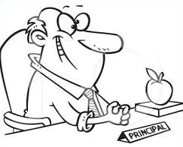
Principles
Guidelines are quite targeted and focus on specific issues, however fundamental principles help provide more clarity and encourage thoughtful discussion and insight into various interface design challenges, as faced by a UX/UI designer.
Determine the users skill level Do not assume you know your users. Interview, evaluate and formulate your users. Characterise the users (age, sex, education, physical and cognitive abilities etc.)
Novice or first time users
Knowledgeable Intermittent users
Expert frequent users
The questionable Principals’ principles
Notes:
http://www.clipartpanda.com/clipart_images/school-principal-66860936
Guidelines and Principles can be found in Designing the User Interface (book by Ben Shneiderman and Catherine Plaisant)

Slide 11
Principles
Guidelines are quite targeted and focus on specific issues, however fundamental principles help provide more clarity and encourage thoughtful discussion and insight into various interface design challenges, as faced by a UX/UI designer.
Identify the tasks With the user profile well characterised, the next step for the developers is to clearly identify the tasks to be carried out.
All identified tasks have their frequency of use and impact estimated
Special keys or shortcuts may be assigned to frequent tasks or activities
Less frequently tasks my involve longer/multiple key strokes for shortcuts
Infrequent tasks may be buried deeper in the menu structure
Notes:
http://www.clipartpanda.com/clipart_images/school-principal-66860936
Guidelines and Principles can be found in Designing the User Interface (book by Ben Shneiderman and Catherine Plaisant)

Slide 12
Principles
Guidelines are quite targeted and focus on specific issues, however fundamental principles help provide more clarity and encourage thoughtful discussion and insight into various interface design challenges, as faced by a UX/UI designer.
Choose an Interaction Style With users and tasks well quantified, the next step is to decide on the interaction style.
Direct Manipulation
Menu Selection
Form Fill-in
Command Language
Natural Language
Notes:
http://www.clipartpanda.com/clipart_images/school-principal-66860936
Guidelines and Principles can be found in Designing the User Interface (book by Ben Shneiderman and Catherine Plaisant)

Slide 13

Principles
Guidelines are quite targeted and focus on specific issues, however fundamental principles help provide more clarity and encourage thoughtful discussion and insight into various interface design challenges, as faced by a UX/UI designer.
The Eight Golden Rules of Interface Design With users and tasks well quantified, the next step is to decide on the interaction style.
Strive for Consistency
Universal Usability
Informative Feedback
Dialogs yield Closure
Prevent Errors
Permit easy reversal of actions (Undo)
Support internal locus of control
Reduce or eliminate memory load
Notes:
http://www.clipartpanda.com/clipart_images/school-principal-66860936
http://www.clipartpanda.com/clipart_images/free-pot-of-gold-clipart-32059459
Guidelines and Principles can be found in Designing the User Interface (book by Ben Shneiderman and Catherine Plaisant)

Slide 14

Principles
Guidelines are quite targeted and focus on specific issues, however fundamental principles help provide more clarity and encourage thoughtful discussion and insight into various interface design challenges, as faced by a UX/UI designer.
Retaining human control The objective of a good user interface (or HMI (Human to Machine Interface)) is to minimise or remove as far as possible, tedious/error-prone/hazardous tasks, leaving the (human) user to focus on:
Making critical decisions
Coping with unexpected events
Planning future actions or activities
Notes:
http://www.clipartpanda.com/clipart_images/school-principal-66860936
http://www.clipartpanda.com/clipart_images/free-pot-of-gold-clipart-32059459
https://www.freepngimg.com/png/35751-robot-file
Guidelines and Principles can be found in Designing the User Interface (book by Ben Shneiderman and Catherine Plaisant)

Slide 15
Principles Group time!
With these Principles in mind, discuss in your groups your different dashboards.
which Principles do you feel influenced the design of your dashboard? Be specific in terms of identifying positive attributes of your dashboard.
Do you feel any of these principles were overlooked, and if so which ones and how?

Slide 16

Theories
Moving beyond guidelines and principles, people in the UX industry are continuing to develop tested, reliable and broadly useful theories. The topic is large, and so is the number of theories.
Theory types Theories can be grouped as follows:
Predictive – compare execution time, error rates etc.
Descriptive – Useful for developing new terminology
Explanatory – sequence of events, cause and effect
Prescriptive – guidance for designers choices
Notes:
http://www.clipartpanda.com/clipart_images/school-principal-66860936
http://www.clipartpanda.com/clipart_images/free-pot-of-gold-clipart-32059459
https://www.freepngimg.com/png/35751-robot-file
https://www.freepngimg.com/download/graphic_design/9-2-graphic-design-download-png.png
Guidelines and Principles can be found in Designing the User Interface (book by Ben Shneiderman and Catherine Plaisant)

Slide 17



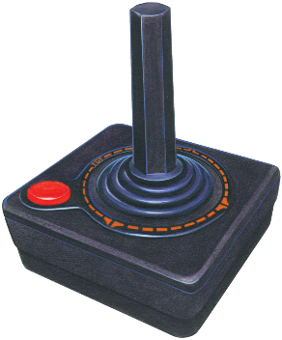
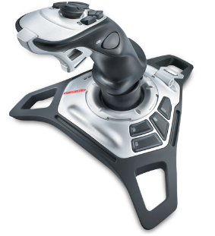
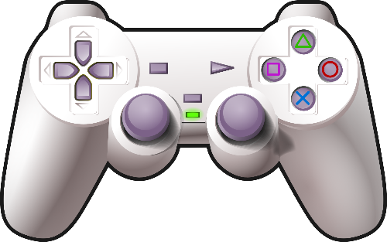
Theories
Moving beyond guidelines and principles, people in the UX industry are continuing to develop tested, reliable and broadly useful theories. The topic is large, and so is the number of theories.
Incompatible input device
Theory types Theories can also be grouped as follows:
Motor – pointing with a mouse, keyboard strokes
Perceptual – locating an object on the display, predicting reading times
Cognitive – sequence of steps to complete a task such as transfer funds
Taxonomies – grouping into understandable catagories e.g. gaming input devices or user personality types (convergent vs divergent)
Notes:
http://www.clipartpanda.com/clipart_images/school-principal-66860936
http://www.clipartpanda.com/clipart_images/free-pot-of-gold-clipart-32059459
https://www.freepngimg.com
Guidelines and Principles can be found in Designing the User Interface (book by Ben Shneiderman and Catherine Plaisant)

Slide 18
Theories
Moving beyond guidelines and principles, people in the UX industry are continuing to develop tested, reliable and broadly useful theories. The topic is large, and so is the number of theories.
Design by levels Similar to software and hardware design, an approach to descriptive theories is to separate concepts according to levels. Once such model is the four level model briefly shown here:
Conceptual Level – the users mental model of the interactive system
Semantic Level – Meaning conveyed by user input to PC output (eg undo a recent (place object) action or delete an object has the same effect: Object removal.
Syntactic Level – How user actions (that convey Semantics) are assembled into complete sentences. e.g “To delete the file, the user can drag to trash can.”
Lexical Level – Deals with specific device dependancies. e.g. “a double mouse click with 200ms executes…”
Notes:
http://www.clipartpanda.com/clipart_images/school-principal-66860936
http://www.clipartpanda.com/clipart_images/free-pot-of-gold-clipart-32059459
https://www.freepngimg.com
Guidelines and Principles can be found in Designing the User Interface (book by Ben Shneiderman and Catherine Plaisant)

Slide 19
Theories
Moving beyond guidelines and principles, people in the UX industry are continuing to develop tested, reliable and broadly useful theories. The topic is large, and so is the number of theories.
Stages-of-Action models An alternative approach to developing explanatory theories is to show the stages of action the users go through in trying to use an interactive device. For example:
Forming the goal
Forming the Intention
Specifying the action
Executing the action
Perceiving the system state
Interpreting the system state
Evaluating the outcome
Notes:
http://www.clipartpanda.com/clipart_images/school-principal-66860936
http://www.clipartpanda.com/clipart_images/free-pot-of-gold-clipart-32059459
https://www.freepngimg.com
Guidelines and Principles can be found in Designing the User Interface (book by Ben Shneiderman and Catherine Plaisant)

Slide 20
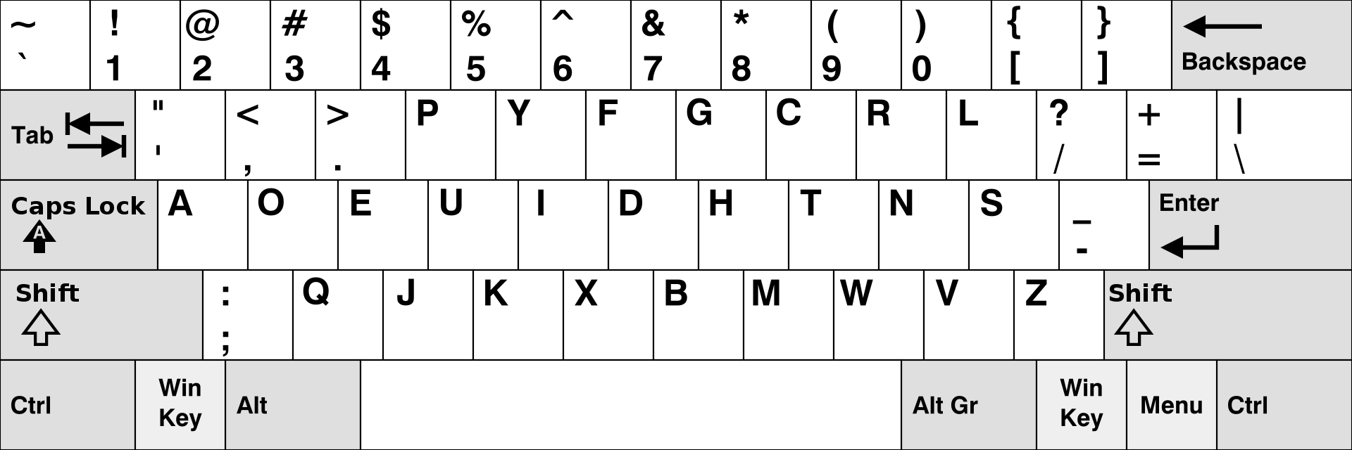
Theories
Moving beyond guidelines and principles, people in the UX industry are continuing to develop tested, reliable and broadly useful theories. The topic is large, and so is the number of theories.
Consistency Consistent use of layout, colours, sounds, icons fonts, font sizes, button sizes, etc. However at times consistencies can be at odds with each other, or there are exceptions where some inconsistency is a virtue. Theories are formed in this regard. A good example of sustained inconsistency is the Qwerty keyboard
Dvorak keyboard
Notes:
http://www.clipartpanda.com/clipart_images/school-principal-66860936
http://www.clipartpanda.com/clipart_images/free-pot-of-gold-clipart-32059459
https://www.freepngimg.com
Guidelines and Principles can be found in Designing the User Interface (book by Ben Shneiderman and Catherine Plaisant)

Slide 21
Theories
Moving beyond guidelines and principles, people in the UX industry are continuing to develop tested, reliable and broadly useful theories. The topic is large, and so is the number of theories.
Contextual theories The testing of theories and user interface prototypes strictly in laboratory style environments is insufficient. The design of a user interface has to take into account the context in which it is used. Some environmental examples may be
The presence (or absence) of other people
Other equipment and machinery
Comfort level (hot, cold, just right)
Time pressure
Noise levels
Availability of writing materials (to make notes, write down details etc.)
Notes:
http://www.clipartpanda.com/clipart_images/school-principal-66860936
http://www.clipartpanda.com/clipart_images/free-pot-of-gold-clipart-32059459
https://www.freepngimg.com
Guidelines and Principles can be found in Designing the User Interface (book by Ben Shneiderman and Catherine Plaisant)

Slide 22
Homework
Read the following resources to further explore how Guidelines and Principles differentiate from each other and how they can assist in the design of your user interface. Guidelines: 10 Rules of Thumb The Basic Principles of User Interface Design
Using a software interface you are familiar with, identify some practical examples of each of the highlighted points today, to improve your understanding of these topics of discussion.
Remember to make hand-written notes (you’ll remember them better!) of all your findings. These notes are permissible for use during tests…
Notes:
http://www.clipartpanda.com/clipart_images/school-principal-66860936
http://www.clipartpanda.com/clipart_images/free-pot-of-gold-clipart-32059459
https://www.freepngimg.com
Guidelines and Principles can be found in Designing the User Interface (book by Ben Shneiderman and Catherine Plaisant)

